Slide 1
Social Media Report
Notes:
Month at a glance
Web Stats – convert to 1 page
Social Results – convert to 1 page
Add page for TashRizzo: Omnichannel
Add Page for SUAS Linkedin Discussion

Slide 2




Top Posts for March 2021 LinkedIn
836
Impressions
24
Clicks
2
Reactions
949
Impressions
24
Clicks
0
Comment
6
Reaction
412
Impressions
8
Clicks
2
Comment
2
Reaction

Slide 3




Top Posts for March 2021 Facebook
295
People Reached
3
Clicks
12
Reaction
188
People Reached
3
Clicks
18
Reaction
265
People Reached
11
Reaction

Slide 4
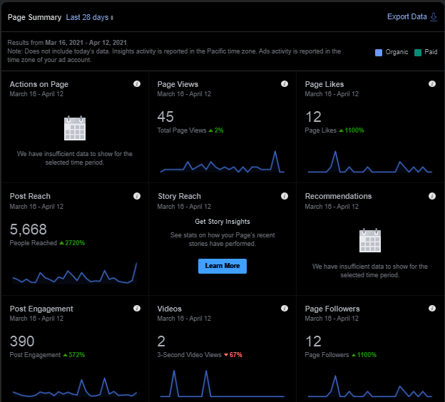
Facebook page insights

Slide 5



Top Posts for March 2021 Twitter
1
Like
1
Like

